Slide 1
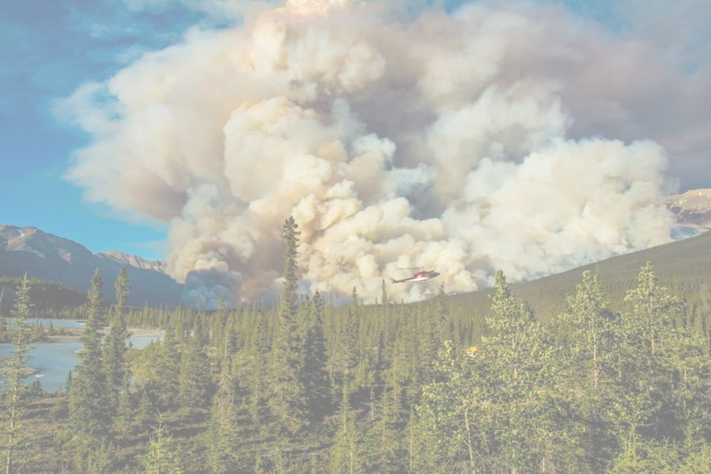
Biomass-based cellular automaton for exploring wildfire
By J Kahn and Helen Miller
QERM 497
March 7, 2023

Slide 2
Presentation Roadmap
Ecological context
Model Description
Experiments + Results
Conclusions
Notes:
H – Ecological context + model description
J – Experiments and Results + conclusions

Slide 3
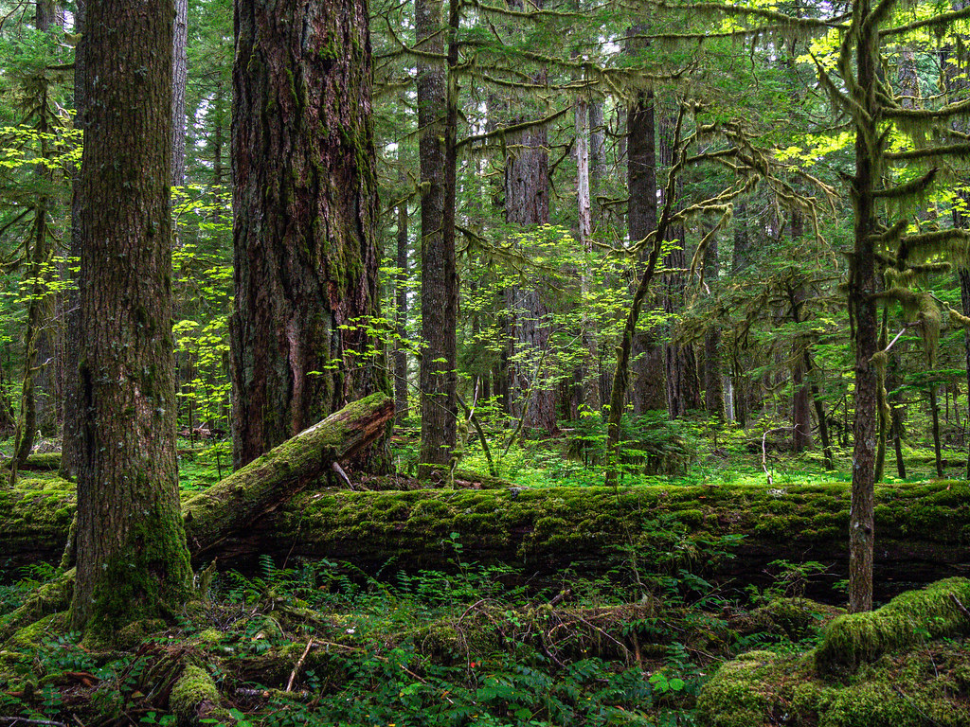
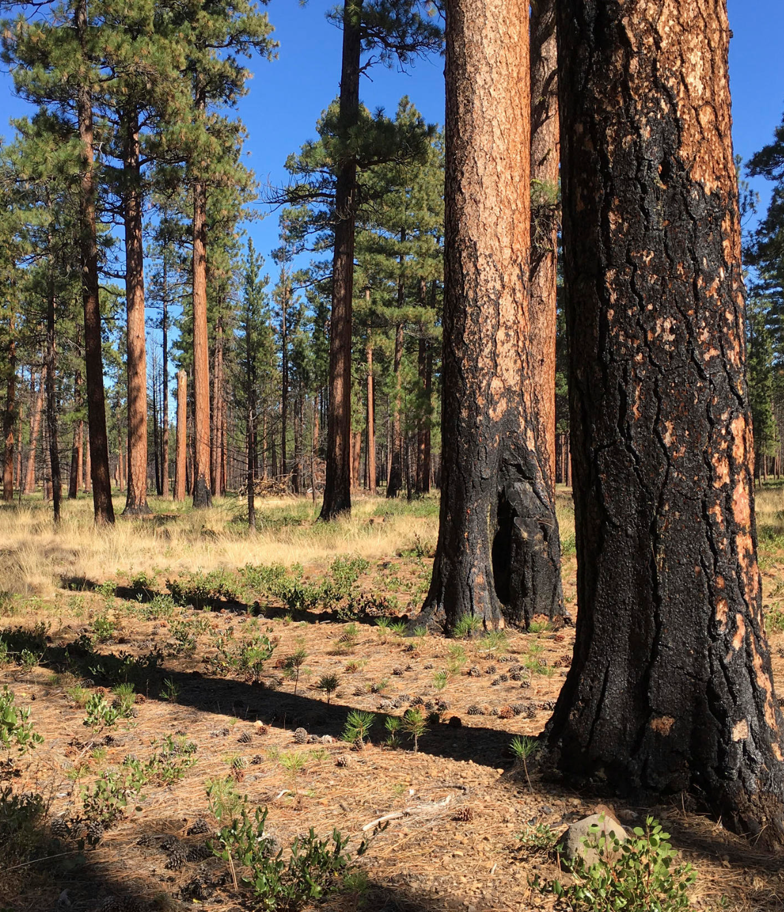
Ecological Context
Western Cascade forest
Eastern Cascade forest
[charasteristics of forest]
[characteristics of forest]
Notes:
https://www.flickr.com/photos/sigmaeye/49928298063/
http://www.knkx.org/post/fighting-fire-fire-prescribed-burn-training-tackles-forest-health-washington

Slide 4
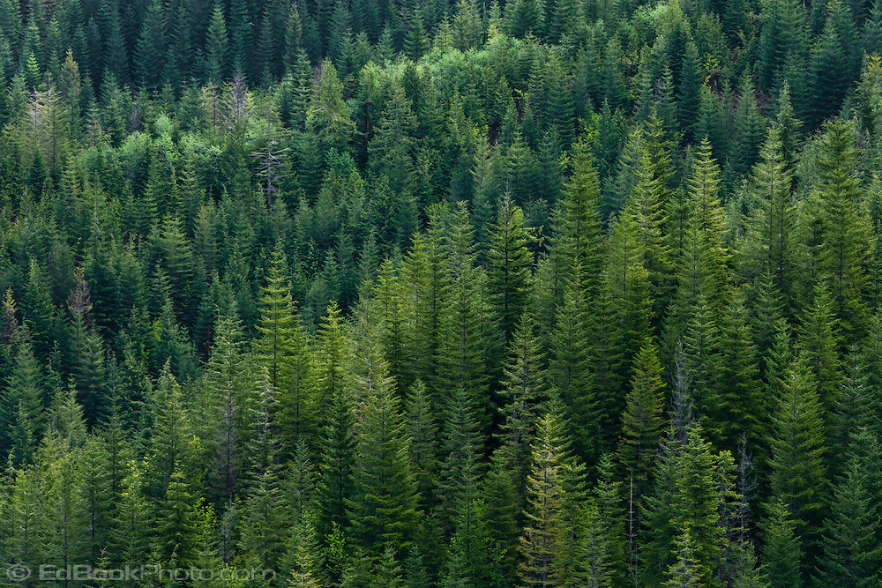
Our Research Questions:
1) Can we create a simple model that qualitatively replicates eastside vs westside fire dynamics?
2) Which parameters are most important for generating these differing dynamics?
Image source
Notes:
Source:

Slide 5
Model overview
Cellular automata model on 2d grid
Each cell takes on a biomass value
varies between 0 and its carrying capacity
Alternate between growth season and fire season for n years
usually takes around 500 for dynamics stabilize
Growth season: Vegetation increases in biomass and propagates to new cells
Fire season: Fires ignite, spread and burn out

Slide 6
Model Setup
Cellular automata model on a 2-D grid
Fixed boundary conditions (natural barriers)

Slide 7


Model Setup
Cellular automata model on a 2-D grid
Fixed boundary conditions (natural barriers)
ASH
VEGETATION
Amount of biomass in each cell increases

Slide 8
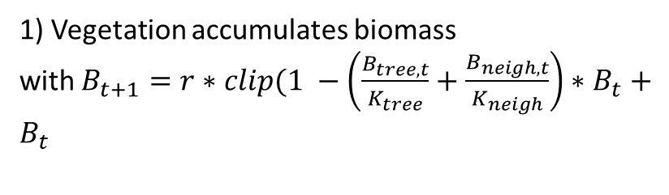
Growth Season
1) Vegetation accumulates biomass
with $B_{t+1}=r∗clip(1 −\left(\frac{B_{tree, t}}{K_{tree}}+\frac{B_{neigh, t}}{K_{neigh}}\right)∗B_{t}+$ $B_{t}$
Before
After
2) Vegetation propagates in neighboring cells
3) Vegetation spontaneously grows in empty cells

Slide 9

Fire season
Before
Ignitions
Ignitions

Slide 10
Pause for pretty simulation

Slide 11
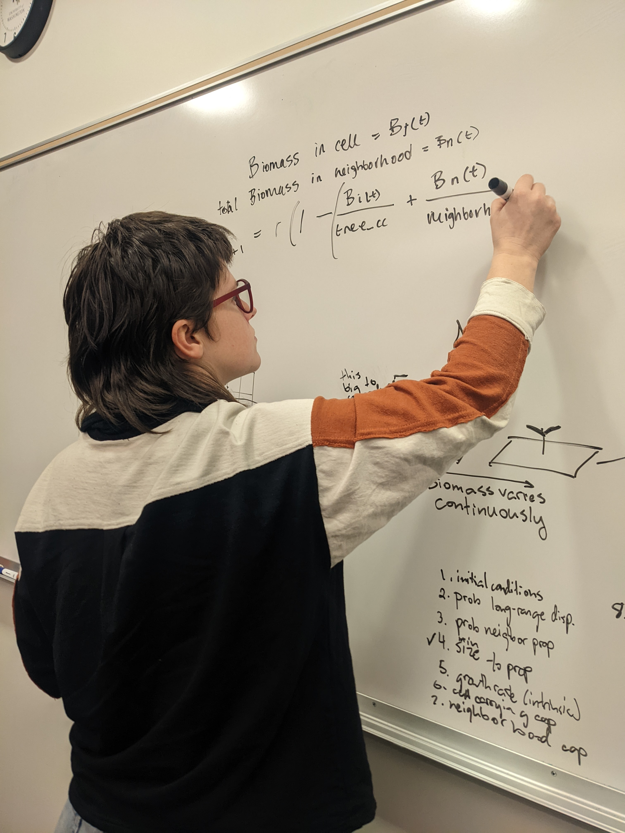
Experiments
2) Eastside vs Westside dynamics
1) Parameter Sweeps

Slide 12
Experiment Set #1: Parameter Sweeps
Vary:
Carrying capacity ratio
Intrinsic growth rate
Carrying capacity (with ratio fixed)
Ignition Probability
Max,
mean,
min
Visual:
Biomass
Parameter value

Slide 13
[plots + interpretation]

Slide 14
Experiment Set #2: Eastside vs Westside Dynamics
Experimental Conditions:
Hand-picked “westside” parameters
Hand-picked
“eastside”
parameters
For a characteristic timestep
Across 500 yrs:
Visual:
Over time:
Biomass
Freq
Freq
Time
Patch size
Area burned

Slide 15
[plots]

Slide 16
Results Discussion

Slide 17
Avenues for future research
Linear relationship bt source size and probability of fire spreading caused semi-unrealistic dynamics
Tiny little grass fires almost never propagate bc of how we generate burn probabilities:
More realistic would maybe be to have a non-linear relationship

Slide 18
Conclusions
Our model is fine
Main parameters that seem to drive diff dynamics are: ratio,
[more stuff]
“Your model is sick. Super sick man!” – Brooke Nelson

Slide 19
Experiment Set #1
Varying ratio of tree_CC / neighborhood_CC
Varied from 1-20
Made a cool plot of mean, max, min biomass
Found: when ratio < 3, do not see oscillations in biomass; when ratio >3, we do (and amplitude of oscillations increases with ratio)
HOWEVER, mean biomass does not continue increasing after ratio >3

Slide 20
Experiment #2
(choose CCratio to be 5)
Varying intrinsic rate of growth between (almost) 0 and 1
Result: no qualitative change to mean/min/max biomass dynamics over time, but oscillations in biomass got larger with higher growth rate

